Slide 1
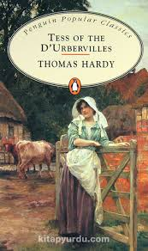

Thomas Hardy and Tess of the D’Urbervilles
Week 13-14
Assist. Prof. Dr. Pelin GÖLCÜK MİRZA

Slide 2
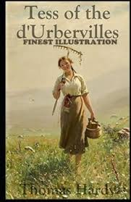
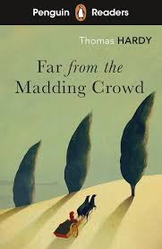
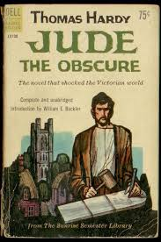

Thomas Hardy (1840-1928)
Early in his career, Hardy trained as an architect in London, and this experience with structure and form influenced the construction and symbolism within his novels.
Hardy is best known for his novels like Tess of the d’Urbervilles, Far from the Madding Crowd, and Jude the Obscure which explore themes of fate, love, and the injustices of Victorian society.
However, he considered himself first as a poet ( «Hap»)
He was buried in the poet’s corner in the west minister Abbey.
Notes:
He suggests the unity and co-dependency of life.

Slide 3
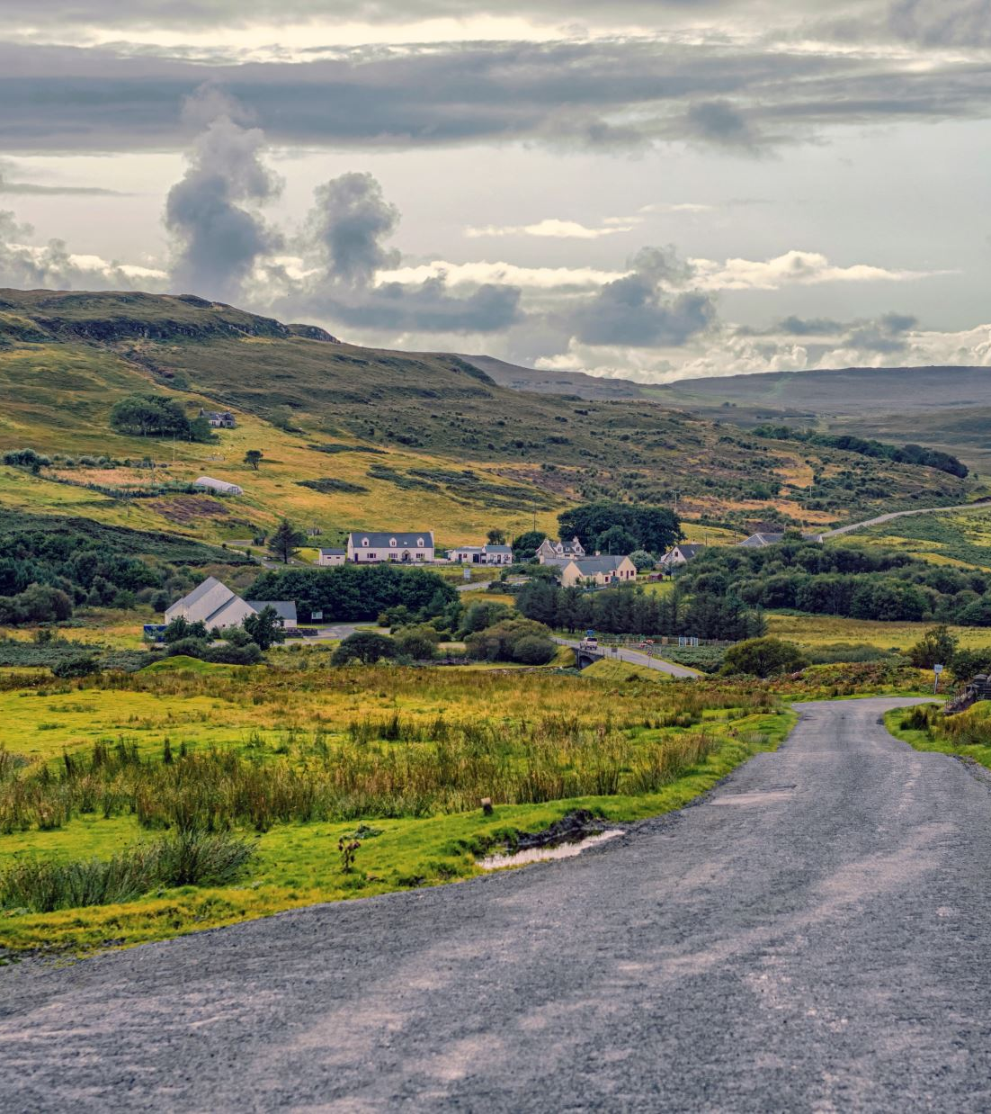
Influences
Hardy is also known for his closure to the rural world, its customs, and the natural landscape of Dorset (fictionalized as «Wessex» in his works) dominates his stories, with nature.
Hardy was aware of the social inequalities, class struggles, and the treatment of women, all of which became major themes in his novels. His novels often reflect his deep contempt for Victorian moral codes, especially their harsh treatment of women like Tess.
Charles Darwin's On the Origin of Species (1859) had a profound impact on Hardy. Darwin’s ideas of survival, natural selection, and the indifference of nature can be seen in Hardy’s portrayal of fate as a force beyond human control.
His novels often depict the «struggle for existence» and humanity’s small place within the vast and uncaring forces of nature.

Slide 4
His Literary Style
Naturalism: According to this philosophy (post-Darwinian period), man belongs entirely to the order of nature and does not have a soul or any other connection with a religious or spiritual world beyond nature. Man is merely a higher animal whose character and fortunes are determined by two kinds of natural forces, heredity and environment.
Heredity gives him his personal traits and compulsive instincts, especially hunger and sex, while environment gives him his impersonal traits and his social and economic instincts.
Hardy’s novels fit within the naturalist tradition, as they emphasize how forces beyond human control such as nature, fate, chance and societal pressures shape and control people's lives. His characters are often powerless in the face of these forces.
(In Tess of the d’Urbervilles, Hardy is obsessed with Tess’s heredity and Tess is constantly subject to forces outside her control, like chance encounters, social expectations, and the randomness of fate)
The novel puts the emphasis on lack of divine determination (see the next slide).
Tragic Realism: Hardy’s stories often depict the harsh realities of life by focusing on suffering, tragedy, and loss. He refuses to offer «happy endings» as seen in Tess's fate. This challenges the reader to confront uncomfortable truths about society, morality, and fate.
Tess's fall from grace is not due to any moral failing of her own but due to forces beyond her control such as rape, societal judgment, and Angel’s hypocrisy.

Slide 5

HAP
If but some vengeful god would call to me
From up the sky, and laugh: “Thou suffering thing,
Know that thy sorrow is my ecstasy,
That thy love's loss is my hate's profiting!”
Then would I bear it, clench myself, and die,
Steeled by the sense of ire unmerited;
Half-eased in that a Powerfuller than I
Had willed and meted me the tears I shed.
But not so. How arrives it joy lies slain,
And why unblooms the best hope ever sown?
—Crass Casualty obstructs the sun and rain,
And dicing Time for gladness casts a moan. . . .
These purblind Doomsters had as readily strown
Blisses about my pilgrimage as pain.

Slide 6
Cont’d..
Simple sentences but complex characters
«To the point» statements but fluid, poetic, detailed depiction of characters and landscapes
Sequential writing ( «Maiden», «maiden no more», «the rally», the «consequence», etc)
Skeptical stance towards life, traditions, religion
Common themes: Skepticism, the clash of fate and free will, and natural imagery.

Slide 7
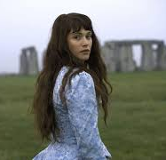
Tess of the Durbervilles
Published in 1891, the novel resists against the Victorian social norms.
Tess’s journey(s) explores innocence, endurance, and societal judgment.
The novel addresses issues of purity, societal expectations, and nature.
Fate Vs Free-will
Paganism vs Christianity

Slide 8
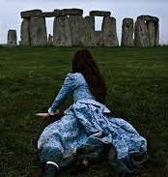
He has much in common with Joyce and Lawrance as with Dickens and George Eliot
Realist in terms of presenting the life as it is with all the details*
Modernist in terms of his associative suggestion and his abundant use of metaphors *
Work scenes:
Rabbits, hares, snakes, rats, mice, retreated inwards as into a fastness, unaware of the ephemeral nature of their refuge, and of the doom that awaited them later in the day when, their covert shrinking to a more and more horrible narrowness, they were huddled together, friends and foes, till the last few yards of upright wheat fell also under the teeth of the unerring reaper, and they were every one put to death by the sticks and stones of the harvesters. (p.77)
Threshing scene
Stonehenge
Victorian Vs Modernist

Slide 9
TESS DURBEYFIELD
Very close to nature
«a peasant by position, not by nature!»
«Why didn't you tell me there was danger in men-folk?»
«You temptress, tess; you dear damned witch of Babylon»
Almost at a leap Tess thus changed from simple girl to complex woman. Symbols of reflectiveness passed into her face, and a note of tragedy at times into her voice. Her eyes grew larger and more eloquent. She became what would have been called a fine creature; her aspect was fair and arresting; her soul that of a woman whom the turbulent experiences of the last year or two had quite failed to demoralize. But for the world’s opinion those experiences would have been simply a liberal education.
Tess in the following different scenes:
May-Dance scene : https://www.youtube.com/watch?v=ICWvTABnMxQ
Claim-kin scene
Rape «Darkness and Silence.. P.64)
Baptizing Sorrow
Threshing at Flintcomb Ash
Dawn at Stonehenge

Slide 10
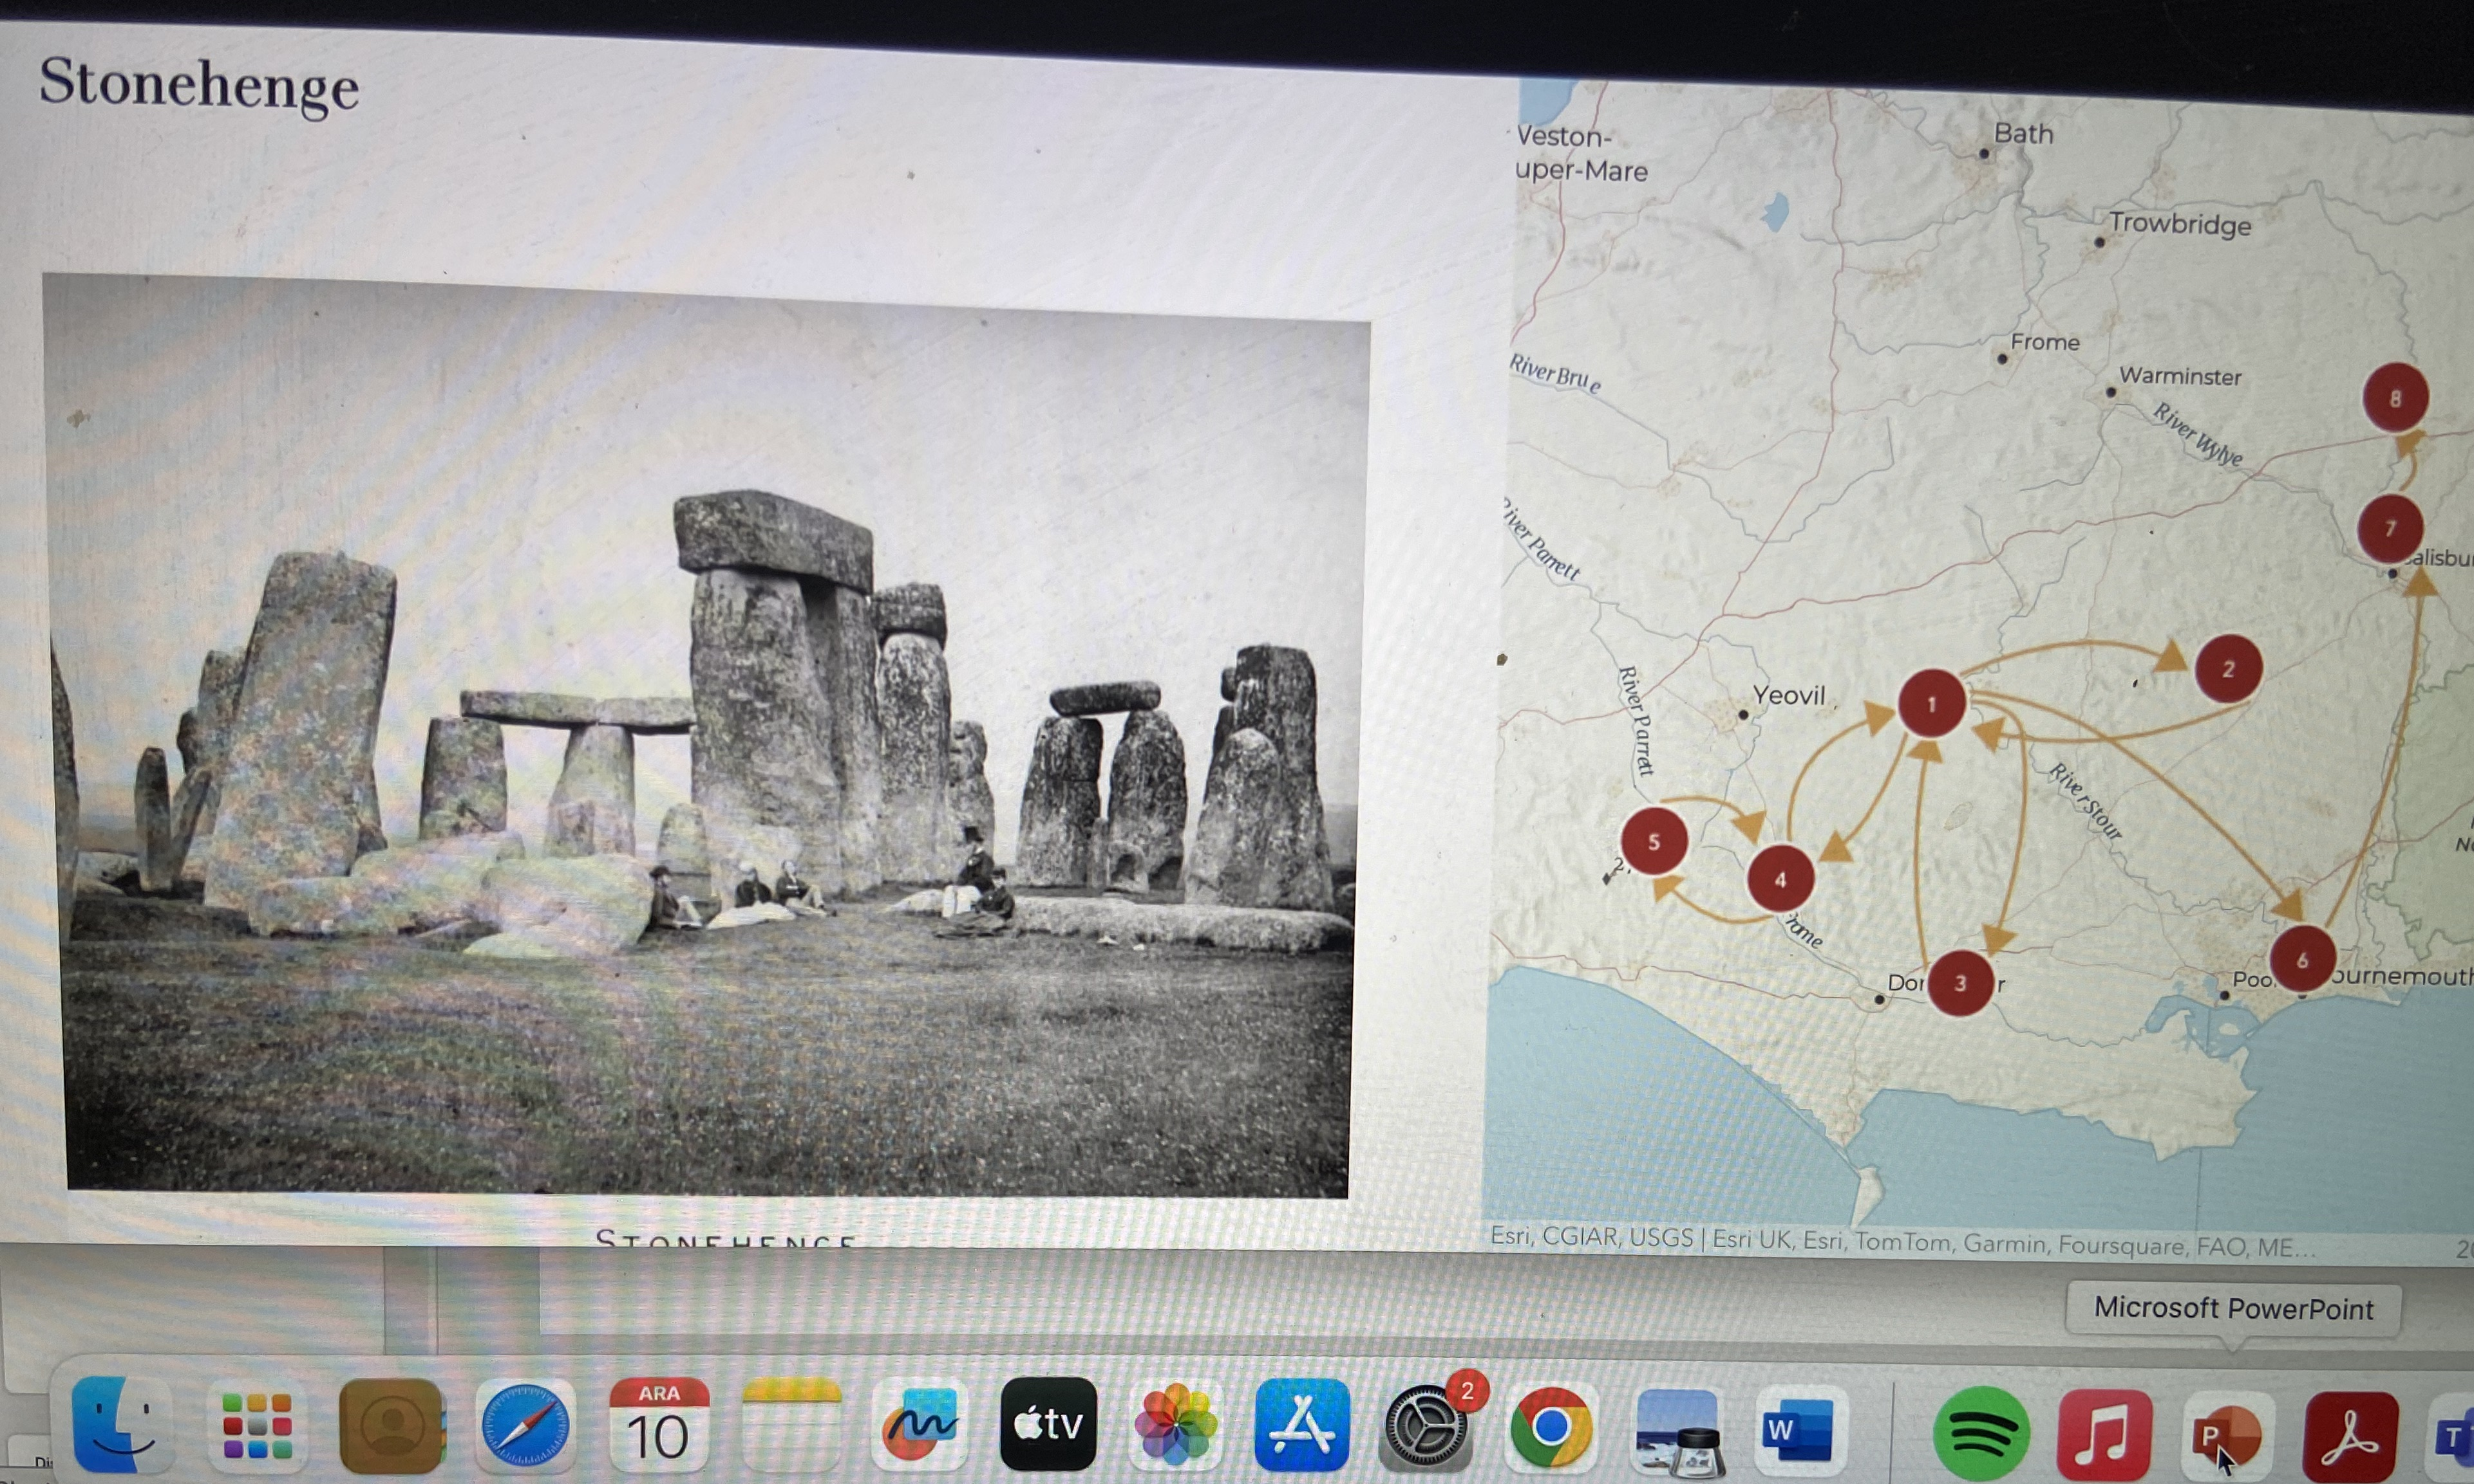
Journey of Tess
Tess as a secular pilgrim?
Tess as a pagan who doesn’t have dogma but morals?
Vale of Blakemore, or Blackmoor (Marlott where the story of Tess begins)
Trantridge Cross (The Chase) (rape scene)
Talbothays (in relationship with Angel )
Flintcomb Ash in Chalk-Newton. (where she meets Alec again)
Stonehenge

Slide 11
Alec
Alec’s personality: moral decay, superficial charm, ultimate hypocrisy:
Tess, my girl, I was on the way to, at least, social salvation till I saw you again.” He smiled, shaking her as if she were a child. “And why then have you tempted me? I was firm as a man could be till I saw those eyes and that mouth again– surely there never was such a maddening mouth since Eve’s.”* His voice sank, and a hot archness shot from his own black eyes. “You temptress, Tess; you dear damned witch of Babylon*– I could not resist you as soon as I met you again!
Alec’s sincerity in his conversion to Christianity
His impact on Tess's fate
Representation of male dominance and moral corruption
Mansplaining?

Slide 12
Angel
Angel’s function in the story
His internal conflict and moral idealism (consider his father, the Reverend Clare) (conformist? Rebellious? Slave to the traditions?)
His impact on Tess’s life and fate
Hypocrisy of Angel (if any?)
Don’t, Tess; don’t argue. Different societies different manners. You almost make me say you are an unapprehending peasant woman, who have never been initiated into the proportions of social things. You don’t know what you say.” “I am only a peasant by position, not by nature.” She spoke with an impulse to anger, but it went as it came. “So much the worse for you. I think that parson who unearthed your pedigree would have done better if he had held his tongue. I cannot help associating your decline as a family with this other fact– of your want of firmness. Decrepit families imply decrepit wills, decrepit conduct. Heaven, why did you give me a handle for despising you more by informing me of your descent! Here was I thinking you a new-sprung child of nature: there were you, the belated seedling of an effete aristocracy!”

Slide 13
Discussion Questions
What does «claiming kin» represent for the characters?
“Doubtless some of Tess d’Urberville’s mailed ancestors rollicking home from a fray had dealt the same measure even more ruthlessly towards peasant girls of their time. But though to visit the sins of the fathers* upon the children may be a morality good enough for divinities, it is scorned by average human nature; and it therefore does not mend the matter.”
‘Justice’ was done, and the President of the Immortals (in Æschylean phrase) had ended his sport with Tess.* And the d’Urberville knights and dames slept on in their tombs unknowing.
How does Tess reflect the plight of women in Victorian society? Chapter 12-13-14
Family, Alec, Society, Angel, Angel’s Family-Alec- Angel- Death
«She had no fear of shadows; her sole idea seemed to be shun mankind.» P.97
Comment on the following settings:
The Chase: woodland, dark, natural innocence, but open to predatory human
The Slopes: artificiality, hypocrisy of aristocrasy
Talbothays Farm: organic beauty, purity, renewal, idealization of working class
How does the novel reflect «seasonal imagery»?
What is the function of using rustic/pastoral imagery?
How does Hardy present the landscapes in the novel?

Slide 14
What is the main function of Angel in Tess’s life?
How can you describe Tess’s position in the Victorian society?
Comment on Alec.
What is the role of nature/pastoral landscape in the novel?
Comment on the concepts of victimhood, endurance, and survival?
Check the baptism of Sorrow
How does Hardy reflect social dynamics of the Victorian life

Slide 15
Discussion
Is Tess a victim of fate, society, or her own choices?
How do Hardy's views on morality influence the story?
Baptism of Sorrow!
What lessons can be drawn from Tess's story?

Slide 16
Fate and Destiny
Comment on the following:
How fate shapes the events of Tess's life
Hardy's concept of inevitable suffering
Role of chance and coincidence

Slide 17
Gender and Societal Expectations
Expectations of Victorian women
Tess's role as a "fallen woman"
The double standard in moral judgment

Slide 18
Purity and Moral Judgment
What "purity" means in the context of the novel
Society's view of Tess vs. her inner purity
Religious and moral undertones given in the novel?

